Slide 1
Mathematical Foundations for Data Science
MFDS Team

Slide 2
DSECL ZC416, MFDS
Lecture No. 8

Slide 3


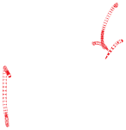


Agenda
LPP in Standard Form
FS, BS, BFS, OBFS
Motivation for the Simplex Method
Simplex tables(using excel)
Sensitivity

Slide 4


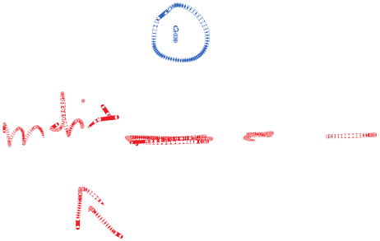








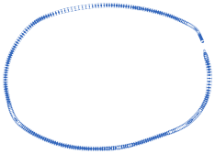



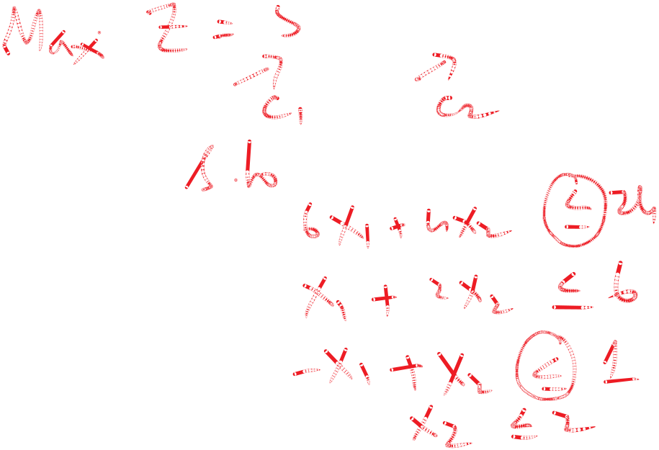





Standard LPP
Max Z = cx
subject to
Ax = b, with b ≥ 0 ;
x ≥ 0;
To be observed:
Constrains have the equality
Non-negativity of b
Non-negativity of variables

Slide 5
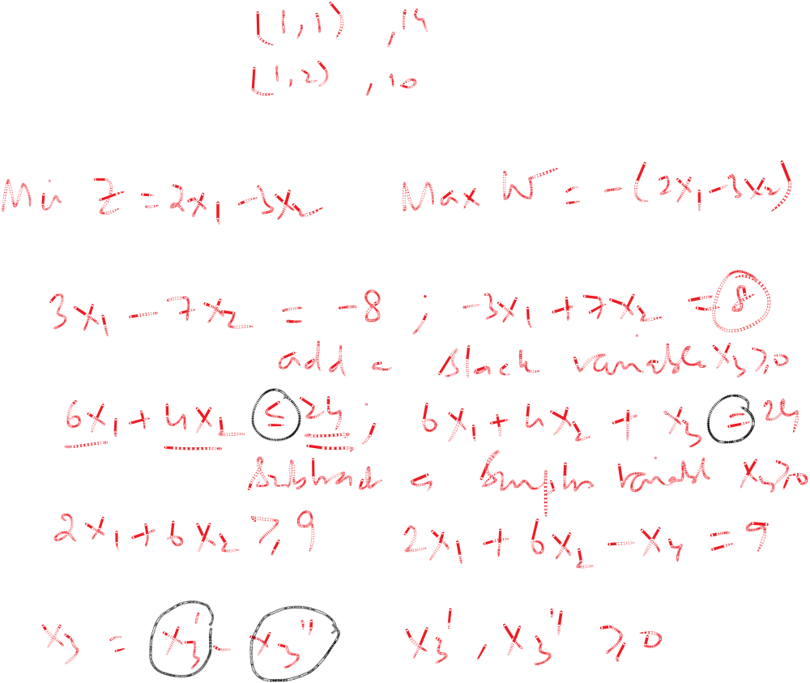
Transformations
Minimization to Maximization
Negative components of b
Constraints with ≤
Constraints with ≥
Variables unrestricted in sign

Slide 6


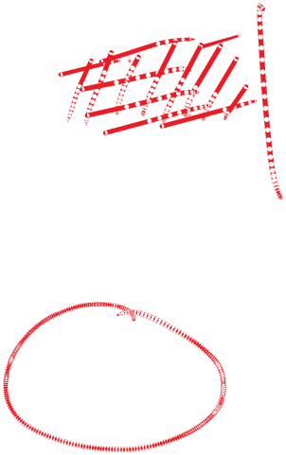


Terminologies
Given m equations in n unknowns (n ≥ m) in standard form
  Set (n-m) variables to zero and determine m unique values
  the (n-m) are called non-basic variables
  the m variables are called basic variables
  a solution that satisfies the constraints and non-negativity –feasible
  a solution that is basic and satisfies (4) is – basic feasible solution (bfs)
  All basic variables are > 0 – non-degenerate bfs
  A bfs that maximizes the objective function is optimal solution

Slide 7

Naive LPP Solvers vs Simplex
The optimal solution, if it exists, is a corner point
  Fundamental theorem of linear programming
Have ^{n}C_{m} ways of finding the corner point (n ≥ m)
Simplex takes just a fraction of the above
Simplex is iterative and simple to interpret

Slide 8
Principles of Simplex Method
Start with an initial basic feasible solution
Improve the initial solution, if possible
Stop, when the bfs cannot be improved
Example: Maximize Z = 5x₁ + 2x₂ + 3x₃ –x₄ + x₅
Subject to x₁ + 2x₂ + 2x₃ +x₄ = 8
3x₁ + 4x₂ + x₃ + x₅ = 7
x_{i} ≥ 0 for all i=1,2,3,4,5

Slide 9
Reddy Mikks Problem
Maximize Z = 5x₁ + 4x₂ + 0s₁ + 0s₂ + 0s₃ + 0s₄
Subject to 6x₁ + 4x₂ + s₁ = 24
x₁ + 2x₂ +s₂ = 6
-x₁ + x₂ +s₃ = 1
x₂ + s₄ = 2
x_{1,} x_{2,} s_{1,} s_{2,} s_{3,} s₄ ≥ 0
(Refer to excel sheet for computational aspects)

Slide 10
Special cases
Unique optimal value
  Relative increase < 0 for all non-basic variables
Alternative optima
  At least one non-basic variable has relative increase = 0
Unboundedness
  The pivot column has entries which are ≤ 0
Infeasibility (not in our scope)
  Artificial variable is there in the final table and is >0

Slide 11
Sensitivity Analysis
Sensitivity Analysis (restricted to graphical solutions)
  Changes in right hand side
      One or more changes is possible
  Changes in objective coefficients
      One or more changes possible
  Complicated changes require concepts in Duality
      Not in the present scope

Slide 12
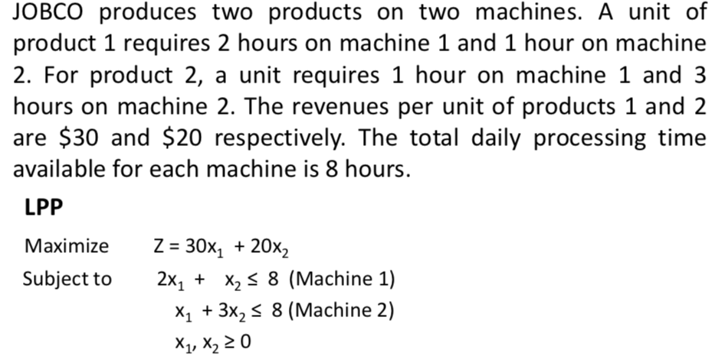
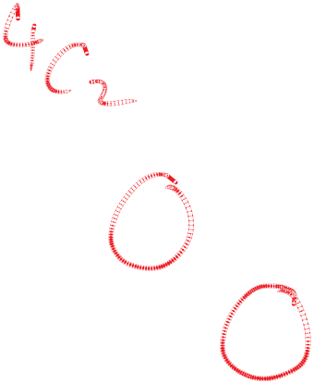

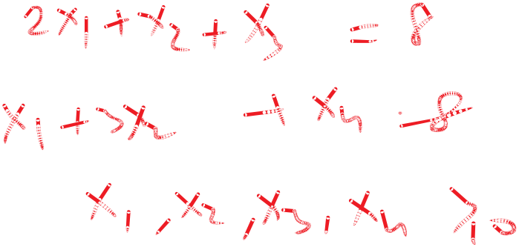
Changes in RHS(Example 3.6-1)

Slide 13
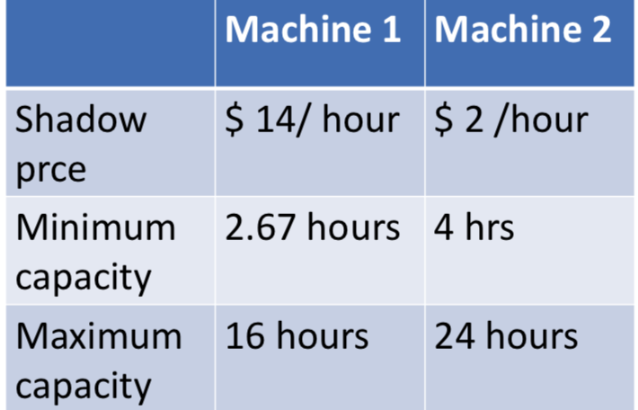
Changes in RHS

Slide 14
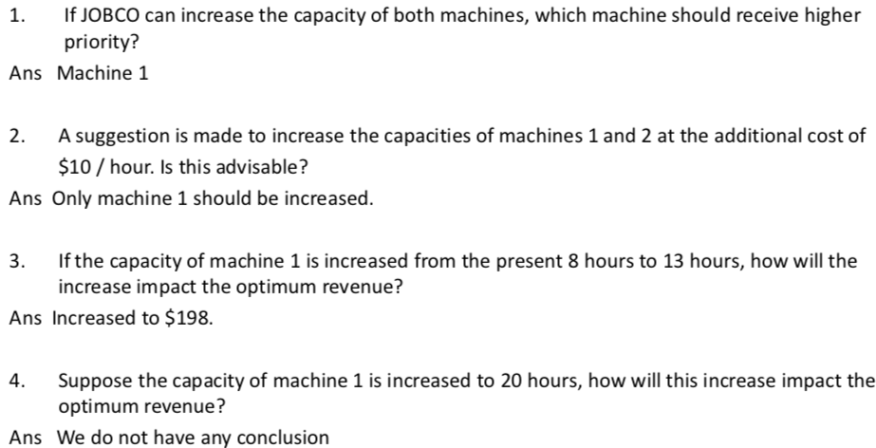
Questions

Slide 15
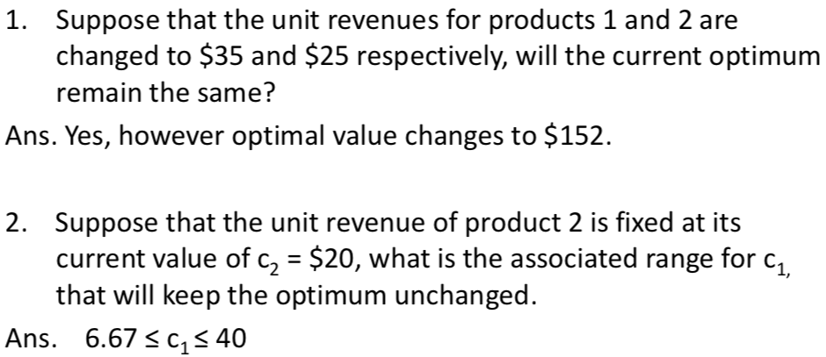
Changes in Objective Coefficients

